Slide 1
Final Project Presentation Individual Project Work MLIS, CS

Slide 2
Details
Sl.No. | Reg. No. | Name of the student | Department
1 | 18ETCS224001 | Anuj Kumar | CSE
Batch : PT_18

Slide 3
Title of the Project
Social Media Analysis for fake news detection and performance comparison on benchmark datasets.
Proposed Mentors
Mentor 1: Dr. Subarna Chatterjee
Proposed Place of Work : Bengaluru

Slide 4
Outline
Introduction
Motivation(Project Concept and its relevance)
Title and Aim
Objectives
Methods and Methodology
Literature Survey
Expected Outcomes
Gantt Chart
References

Slide 5
Introduction

Slide 6
Introduction
A specific and context based fake news classifier was trained on coronavirus dataset for group project using data curated from newspaper .
The trained model was limited to above topic only and hence could not be generalized. Also, the model was huge in size and hence could not be trained easily, also it did not predict any reason behind the classification as to why the given sentence is fake or real.
Through the current work, we look into the above problems to try to provide a more generic as well as robust approach to fake news classification.
The current approach uses data extracted from social media and also generic datasets, and provides a scalable and fast machine learning classifier for helping to decide which particular news item is fake or real.

Slide 7
Motivation (Project Concept and its relevance)
Fake news is both a social and technical problem.
It is hard to solve problem due to varying context and language. Often, it depends upon the perspective, opinion, bias and readers mindset to identify if any news item is fake, construed, distorted or made-up.
Solving fake news issue is one of the most interesting problem in natural language processing. It is particularly more dangerous if not solved in the today’s digital age of internet and social media where there is plethora of mis-information spreading around every minute.

Slide 8
Title and Aim
Title:
Social Media Analysis for fake news detection and performance comparison on benchmark datasets.
Aim:
Design a generic and robust fake news classifier
Applicable for wider media such as newspaper, social media etc.
Try to beat the benchmark on reference data

Slide 9
Objectives
There are already a lot of work done in the area of fake news classification. But, often the systems designed lacks a “generalization” of approach that could work in real world scenario. Most models either don’t identify the context, are trained on a narrow dataset, depends too much to meta-information such as users, likes, comments or shares on posts or are trained on huge datasets of terabytes of data which requires hundreds of hours of training time.
Somewhere a middle ground approach is missing which can be fast and still accurate and also provide insights on why certain post or news is fake or not fake.

Slide 10
Methods and Methodology
As this work is an extension of previous work during group project, here we provide methods and methodology over and above what has already been described in group project.
Objective | Methods and Methodology | Tools and technology
Data-set selection | Literature survey | NA
Literature Survey | Paper readings | NA
Benchmark and baseline identification | Paper readings | NA
Model training and inference | Paper reading, development and implementation through code and logic | Python
Social Media applicability | Development and implementation through code and logic | Python

Slide 11
Summary of Group Project
Coronavirus news collected from newspapers and fact checking websites. Newspapers considered were Times of India, Indian Express, Hindustan Times, The Hindu, DNA and New Indian Express and fact checking sites such as WHO.
Each news articles were preprocessed and descriptive analytics implemented.
A transformer based natural language processing algorithm called RoBERTa (robustly optimized BERT) was trailed and customized with hyper-parameters.
Model was trained and inference was made on this dataset.
The work was published in ICACI-2020 conference where it won the ‘BEST PAPER’ award.

Slide 12

Best Paper

Slide 13
Flow chart
Collect data from Newspapers, Social Media and Benchmark datasets
Apply specific preprocessing methods on each datasets based on its content and project requirement
Implement basic statistics and data visualizations
Train multiple classification models and pick the best performing model.
Transformer based BERT classification model performs best.
Further customize and enhance the BERT capability by inhouse development
Analyze model metrics and run inference on benchmark datasets as well as tweets.

Slide 14
Data Description

Slide 15
Data Approach
Three Approaches:
Get data from various newspapers (done in Group Project)
Extract data from social media platforms (Twitter)
Collect benchmark datasets curated by different researchers and institutions

Slide 16
Social Media Data
We wrote a twitter API to extract tweets from twitter.
5000 tweets extracted on specific topics (hashtags)
As these tweets do not have labels associated with it, we used these to run inference on model trained using benchmark datasets.

Slide 17
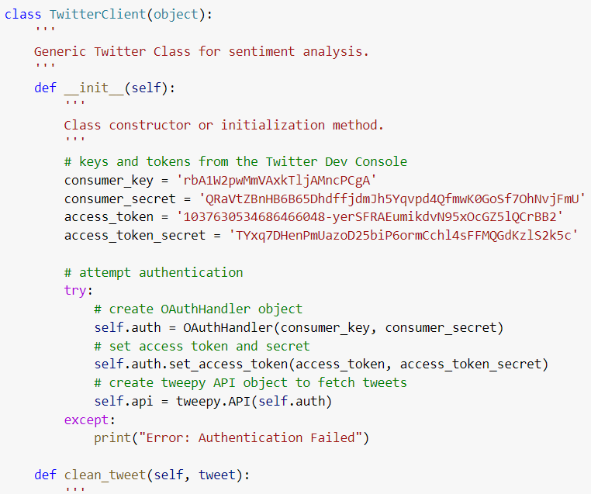
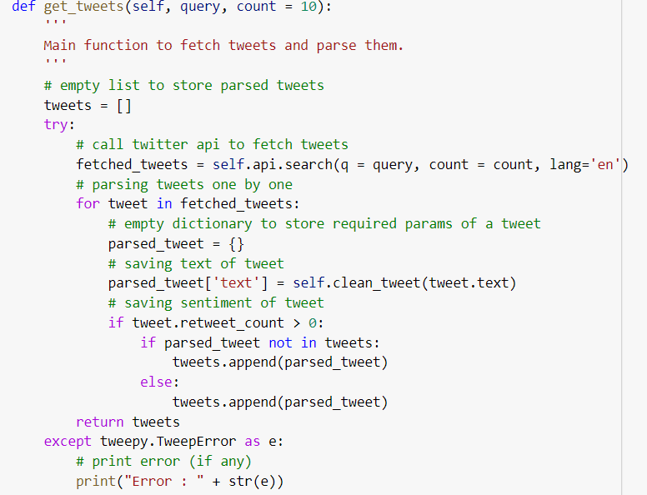
Twitter API

Slide 18
Benchmark Datasets
Sr. No | Dataset Name | Description | Dimensions | Source
1 | Fake and Real News dataset | News articles collected from various newspapers. Mainly political news and world news | 51 MB – True set No. of True articles #21418 59 MB – Fake set No of Fake articles #23481 | 1. Kaggle https://www.kaggle.com/clmentbisaillon/fake-and-real-news-dataset/data?select=True.csv 2. University of Victoria https://www.uvic.ca/engineering/ece/isot/datasets/fake-news/index.php 3. Dataset paper https://arxiv.org/pdf/2002.01030.pdf
2 | Coronavirus dataset | Collected from social media posts and news websites | 586 Real news 578 Fake News | https://towardsdatascience.com/explore-covid-19-infodemic-2d1ceaae2306

Slide 19
Benchmark Datasets (continued)
Sr. No | Dataset Name | Description | Dimensions | Source
3 | FNID: Fake News Inference Dataset PolitiFact | existing samples of the PoliticFact.Com website have been crawled using the API | 15212 training, 1058 validation, 1054 test | FakeNewsNet PolitiFact https://ieee-dataport.org/open-access/fnid-fake-news-inference-dataset#files
4 | FNID: Fake News Inference Dataset LIAR | classes in this data are pants-fire false, barely true, half-true, mostly-true true. | 15052 training 1265 validation 1266 test | LIAR dataset https://ieee-dataport.org/open-access/fnid-fake-news-inference-dataset#files

Slide 20
Baseline Result

Slide 21
Baseline Results published by other researchers
Dataset ID | Dataset name | Results | Source
1 | Fake and real news dataset | 99% accuracy | http://kaggle.com/clmentbisaillon/fake-and-real-news-dataset/notebooks
2 | Coronavirus dataset | 84% accuracy | https://github.com/susanli2016/NLP-with-Python/blob/master/AutoDetect_COVID_FakeNews.ipynb
3 | FNID | 69% accuracy | https://arxiv.org/pdf/1809.01286.pdf
4 | LIAR | 76% accuracy, 24% on multi-class | https://www.researchgate.net/figure/Performance-comparison-on-LIAR-dataset_tbl1_328650077

Slide 22
Method used in Baseline Result
Dataset Name | Method Used
Fake and real news dataset | LSTM
Corona virus dataset | Support Vector Machine (SVM)
FNID | Social Article Fusion*
LIAR | UFD**
*Social Article Fusion(SAF) model that combines SAF /S and SAF /A is used. This model uses autoencoder with LSTM cells of 2 layers for encoder as well as decoder and also temporal pattern of the user engagements are also captured using another network of LSTM cells with 2 layers. [Shu, Mahudeswaran, and Liu 2018]
** UFD is unsupervised fake news detection which utilizes a probabilistic graphical model to model the truths of news and the users’ credibility. An efﬁcient collapsed Gibbs sampling approach is used to solve inference. [Yang, S., Shu, K., Wang, S., Gu, R., Wu, F., & Liu, H. (2019, July)]

Slide 23
Data Handling

Slide 24
Data Preprocessing
Dataset | Pre-Processing Methods
Social Media Data | Removal of links and special characters Removal of non- English words and numbers Counting word distributions, build word cloud and tweet sentiments
Fake and Real News dataset | Check for Missing value Check for duplicates Remove special characters Convert to lower case Word count distribution for fake and real sets Word Cloud
Corona-virus dataset | Sentiment Analysis for fake and real sets Polarity detection Polarity for specific sources in fake and real sets Visualizations Unigram and Bigram analysis
FNID | Non English and special characters removal Word Length Distribution for each classes Word Cloud for each class
LIAR | Word Length Distribution for each classes Word Cloud for each of the six classes

Slide 25
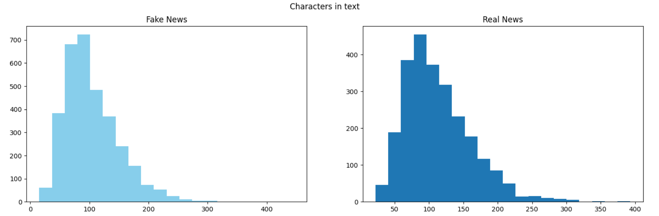
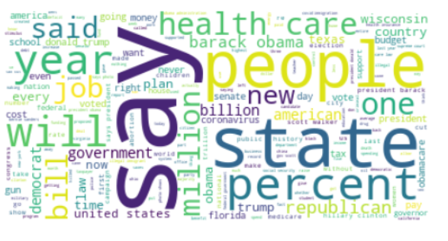
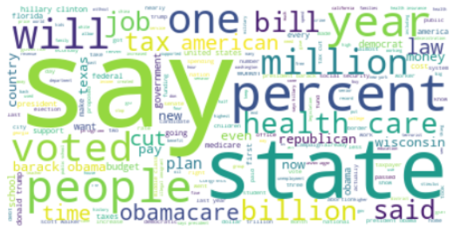
Data Preprocessing (Continued)

Slide 26
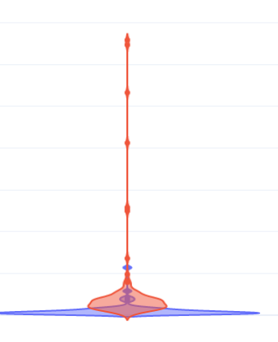
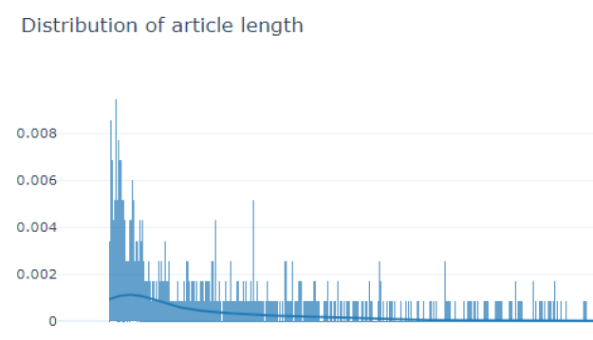
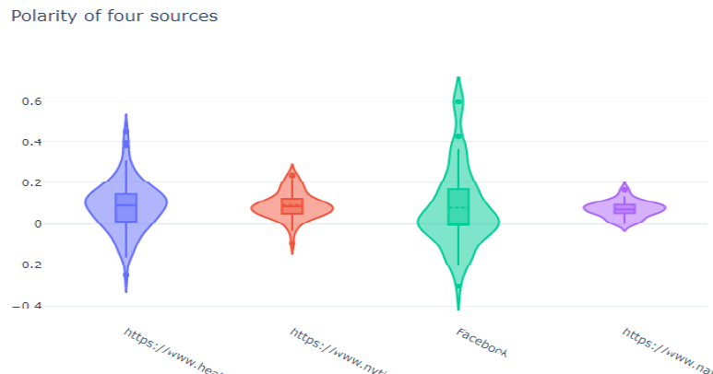
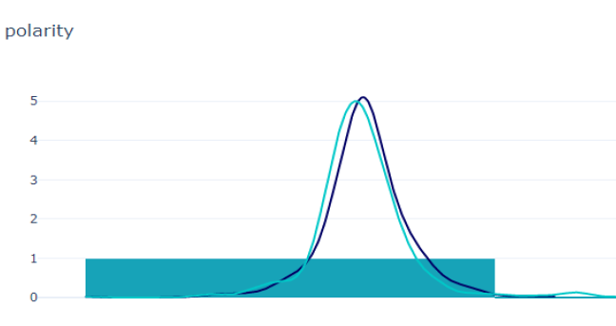
Data Pre-processing(Continued)

Slide 27
Feature Engineering
Dataset | Feature Engineering
Fake and Real News dataset | 5 columns available : ID, Title, Author, Text, Label Title and Text are highly correlated Author name does not influence in prediction We consider Text and Label for Modelling
Corona-virus dataset | 2 columns available: Title and Label We use both for modelling
FNID | 8 columns available: statement, Label, Article etc. We use backward selection method to identify important columns Cosine similarity is used to measure correlation Statement and label columns are used for modelling
LIAR | 8 columns available: statement, Label etc. We use backward selection method to identify important columns Cosine similarity is used to measure correlation Statement and label columns are used for modelling

Slide 28
Modelling

Slide 29
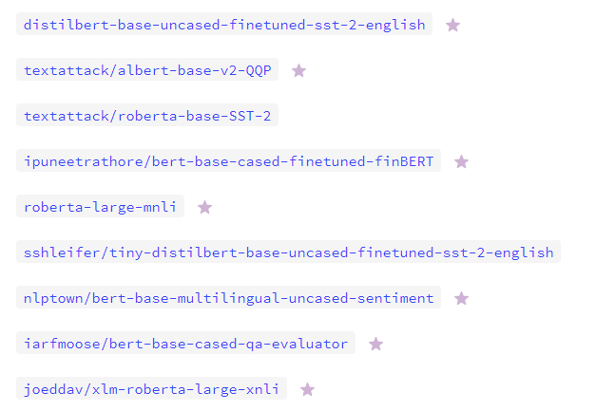
Transformers
Use Transformers

Slide 30
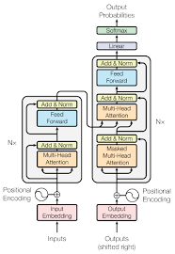
Transformer Architecture
Input Encoding: word embedding of input sentences is performed here.
Encode Block: it contains a multi head attention unit along with a feed forward network.
There could be as many as 6 attention units in encoder in BERT
Decoder Block: this converts the encoded sequence to a prediction range.

Slide 31
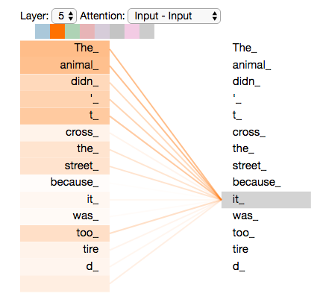
Self-Attention Computation
How self-attention is implemented:
The word embedding is transformed into three separate matrices -- queries, keys, and values -- via multiplication of the word embedding against three matrices with learned weights.
For each word embedding, for each word embedding (e.g. n2n2 times), calculate the dot product of the current word's query vector with that word's key vector. E.g. for w1 in a sentence with just two words in it we would calculate: {q1 dot k1, q1 dot k2}.
The query and key vectors are turned into a single value via the dot product.
They are then adjusted via normalization and softmax.
Multipy each word embedding's value vector by its softmax (this squeeze out low-value words, which will have a low softmax vector).
Sum the results.

Slide 32
BERT
BERT (Bidirectional Encoder Representations from Transformers) is a recent paper published by researchers at Google AI Language. BERT’s key technical innovation is applying the bidirectional training of Transformer, a popular attention model, to language modelling.
Bidirectionally trained can have a deeper sense of language context and flow than single-direction language models.
There are more advanced versions of bert as well such as RoBERTa and also different pre trained bert models for different languages.

Slide 33
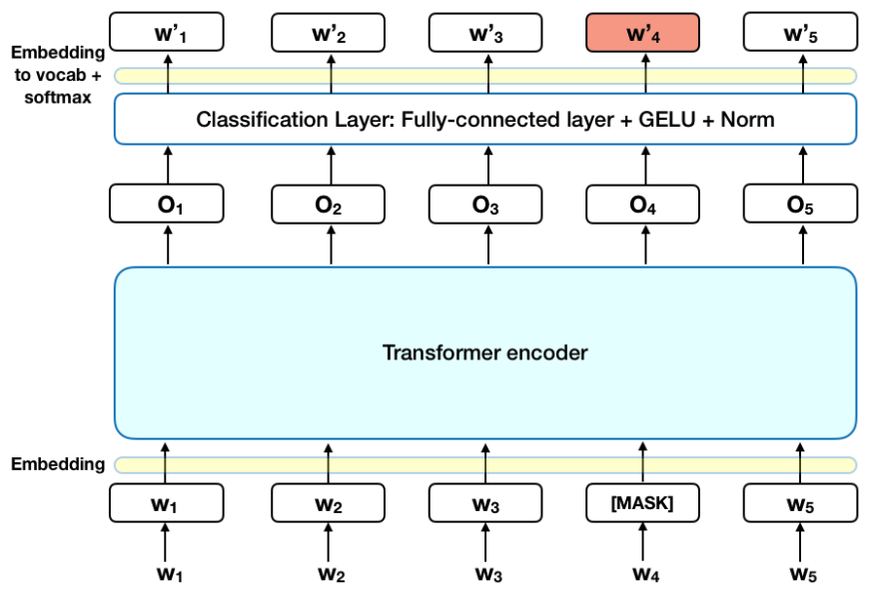
BERT Architecture

Slide 34
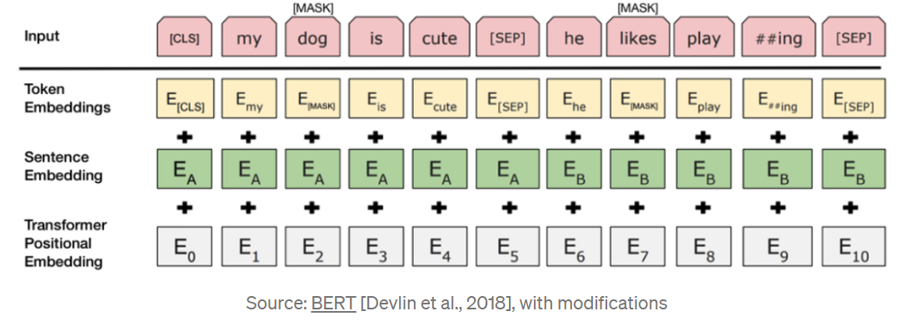
BERT Encoding

Slide 35
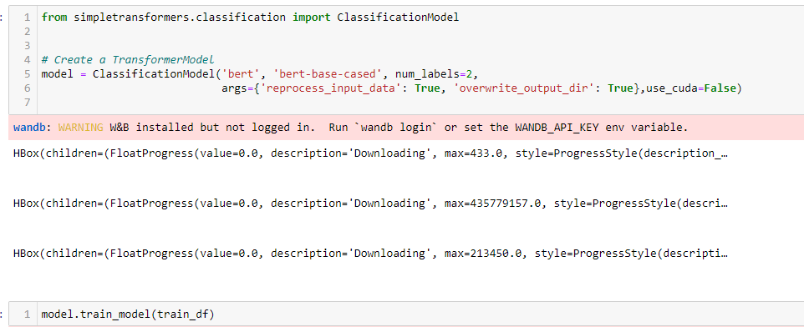
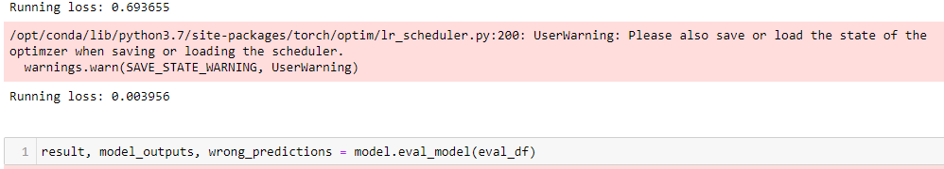
Model

Slide 36
Model Hyper-Parameters
BERT Model Parameters
'fp16': False, 'fp16_opt_level': 'O1', 'max_seq_length': 128, 'train_batch_size': 50, 'eval_batch_size': 50, 'gradient_accumulation_steps': 1, 'num_train_epochs': 1, 'weight_decay': 0, 'learning_rate': 1e-3, 'adam_epsilon': 1e-8, 'warmup_ratio': 0.06, 'warmup_steps': 0, 'max_grad_norm': 1.0, 'logging_steps': 50, 'evaluate_during_training': False, 'save_steps': 2000, 'eval_all_checkpoints': True, 'use_tensorboard': True,

Slide 37
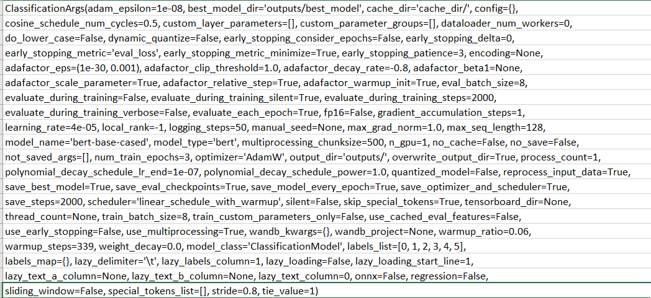
Model Arguments

Slide 38
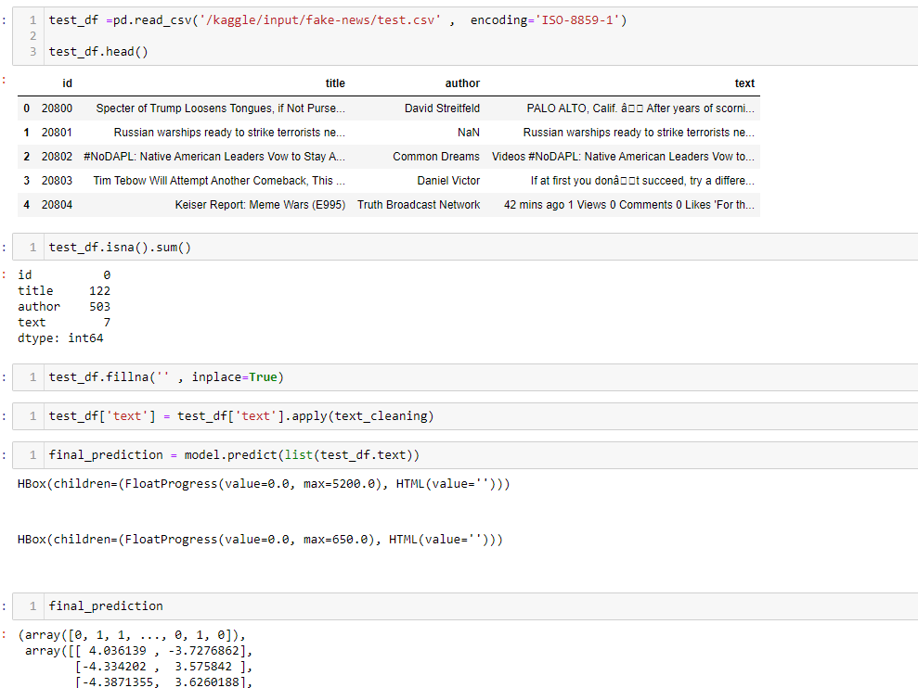
Model Prediction

Slide 39
Fake News Inference from Social Media

Slide 40
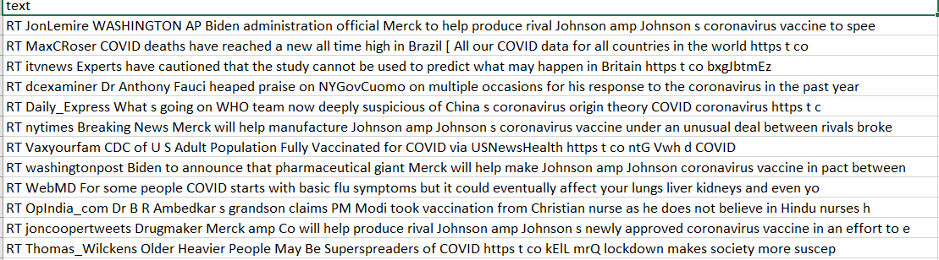
Tweets Extraction and Pre-processing
Extract Tweets from twitter using API
Run Transformer based Classification Model trained on static data
Run Inference on Tweets extracted from twitter

Slide 41
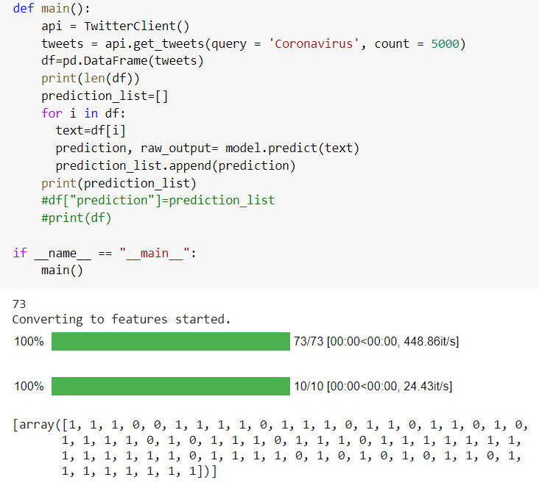
Inference on tweets

Slide 42
Modelling Result

Slide 43
Result Dataset#1 (Fake and Real News Dataset)
 | Precision | Recall | F1-score | Support
Class 0 | 0.972 | 0.984 | .994 | 547
Class 1 | 0.974 | 0.982 | 0.990 | 473
Accuracy |  |  | 0.992 | 1020
Macro avg | 0.97 | .983 | 0.992 | 1020
Weighted avg | 0.97 | .983 | 0.993 | 1020

Slide 44
Result Dataset#2 (Corona-virus Dataset)
 | Precision | Recall | F1-score | Support
Class 0 | 0.84 | 0.85 | 0.88 | 163
Class 1 | 0.80 | 0.79 | 0.84 | 128
Accuracy |  |  | 0.86 | 291
Macro avg | 0.82 | 0.82 | 0.86 | 291
Weighted avg | 0.82 | 0.82 | 0.86 | 291

Slide 45
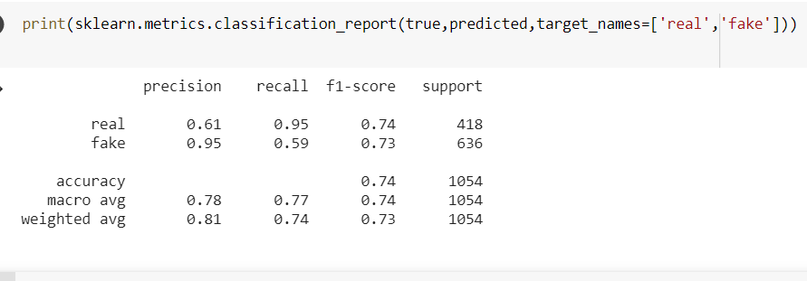
Result Dataset#3 (FNID)

Slide 46
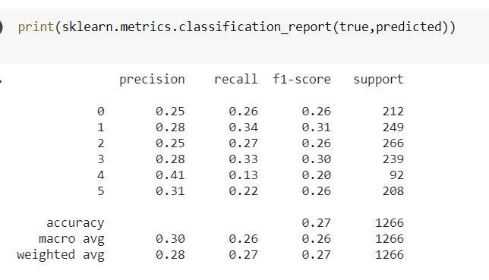
Result Dataset#4 (LIAR)

Slide 47
Result Analysis

Slide 48
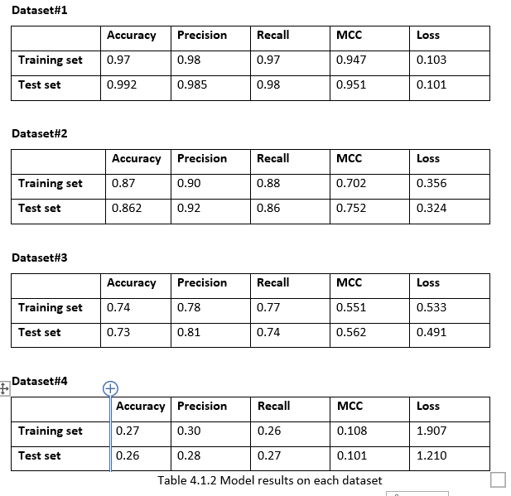
Comparison of Model on Standard Datasets

Slide 49
Execution time and Memory Size Requirements
Dataset | Execution Time | Model Size
Fake and Real news dataset | 9 min 15 sec | 800MB
Corona-virus dataset | 1min 21 sec | 320MB
FNID | 7 min 24 sec | 740MB
LIAR | 21 min 17 sec | 1.5 GB

Slide 50
Comparison Current vs Baseline

Slide 51
Comparison of Model with published result
Dataset | Current Result | Published Baseline Result
Fake and real news dataset | 99.2% | 99%
Coronavirus dataset | 86.2% | 84%
FNID | 73% | 69%
LIAR | 26% | 24%

Slide 52
Baseline Approach vs Current Approach
Current Approach | Baseline Approach
Advantages: -- Uses deep learning ideas -- can handle long sentences -- remembers contexts over large sequence -- pre-trained -- provides state of the art performance -- can handle large types of use cases -- highly robust | Advantages: -- smaller model -- memory and time efficient -- faster inference -- suitable for smaller datasets with less complexity
Disadvantages: -- requires huge training time -- requires huge compute setup such as GPU -- requires advanced deep learning and transformer skill -- difficult to be used in near real time inference scenarios | Disadvantages: -- less accuracy -- performance degrades for longer sentences -- can not beat state of the art results -- Old techniques with little scope of improvements

Slide 53
Demonstration

Slide 54
Conclusion
Our goal was to design a machine learning based system which could identify and predict from a news article if the content is fake or real. Machine learning can be used for social good such as fake news identification. Our approach shows that after much pre-processing of relatively small predefined dataset, an NLP/ML Model is able to pick up on a diverse set of potentially subtle language patterns that a human may (or may not) be able to detect.
our model looks for indefinite or inconclusive words, referential words, and evidence words as patterns that characterize real news. Transformers are naturally good at identifying the context from large sequence of words hence can be quite powerful in tasks such as sentence completion, language translation, question answering or text classification. Even if a human could detect these patterns, they are not able to store as much information as a ML model, and therefore, may not understand the complex relationships between the detection of these patterns and the decision for classification. As such, this seems to be a really good start on a tool that would be useful to augment human’s ability to detect Fake News.

Slide 55
Future Work
Build and train models for languages other than English preferably Indian languages.
Beat the benchmarks on even bigger and more complicated datasets such as yelp restaurant reviews which require much more compute and processing resources as dataset size is much larger and thus a distributed or big data approach is more suitable.
Use datasets which does not only contain plain text but reach multi-media such as images and videos as well. These days, a lot of fake news is spread through images and videos which needs a completely different approach.
Designing a system which can work in real time and consume latest information to identify content as fake or real as in today’s world information spread across the worlds in minutes and hence the detection needs to be also done almost instantly.

Slide 56
References
Granik, M. and Mesyura, V., 2017, May. Fake news detection using naive Bayes classifier. In 2017 IEEE First Ukraine Conference on Electrical and Computer Engineering (UKRCON) (pp. 900-903). IEEE.
Shu, K., Sliva, A., Wang, S., Tang, J. and Liu, H., 2017. Fake news detection on social media: A data mining perspective. ACM SIGKDD Explorations Newsletter, 19(1), pp.22-36.
Shu, K., Wang, S. and Liu, H., 2019, January. Beyond news contents: The role of social context for fake news detection. In Proceedings of the Twelfth ACM International Conference on Web Search and Data Mining (pp. 312-320).
Ahmed, H., Traore, I. and Saad, S., 2017, October. Detection of online fake news using N-gram analysis and machine learning techniques. In International Conference on Intelligent, Secure, and Dependable Systems in Distributed and Cloud Environments (pp. 127-138). Springer, Cham.
Liu, Y. and Wu, Y.F.B., 2018, April. Early detection of fake news on social media through propagation path classification with recurrent and convolutional networks. In Thirty-Second AAAI Conference on Artificial Intelligence.
https://arxiv.org/pdf/1812.00315.pdf
https://www.kdd.org/exploration_files/19-1-Article2.pdf
https://www.theatlantic.com/technology/archive/2018/03/largest-study-ever-fake-news-mit-twitter/555104/ss
https://www.kaggle.com/clmentbisaillon/fake-and-real-news-dataset/data?select=True.csv
https://www.kaggle.com/madz2000/nlp-using-glove-embeddings-99-7-accuracy
https://towardsdatascience.com/explore-covid-19-infodemic-2d1ceaae2306
https://ieee-dataport.org/open-access/fnid-fake-news-inference-dataset#files
https://www.uvic.ca/engineering/ece/isot/datasets/fake-news/index.php
https://arxiv.org/pdf/2002.01030.pdf
[Shu, Mahudeswaran, and Liu 2018] Shu, K.; Mahudeswaran, D.; and Liu, H. 2018. Fakenewstracker: a tool for fake news collection, detection, and visualization. Computational and Mathematical Organization Theory 1–12.
Yang, S., Shu, K., Wang, S., Gu, R., Wu, F., & Liu, H. (2019, July). Unsupervised fake news detection on social media: A generative approach. In Proceedings of the AAAI conference on artificial intelligence (Vol. 33, No. 01, pp. 5644-5651).

Slide 57
Thank You

